Slide 1
COVID PATIENT HEALTH MONITORING SYSTEM

Slide 2
INTRODUCTION
Independent and convenient, healthy living is the aim of any human being no matter their age, gender, location or health status. However, there are limitations due to age, illness, medication, hospitalization, epidemic, pandemic and other circumstances. Health monitoring systems have evolved to assist convenient healthy living, more accessible communication between healthcare givers and patients for close monitoring, measurement of vital health parameters, routine consultation and overall healthy living.
Moreover, with the recent advances in information and communication technologies (ICT) through the adoption of Internet of Things (IoT) technology. However, a shortage of home health helpers, nursing assistants and home healthcare givers is looming worldwide. Therefore, a health monitoring system can play a vital role in lessening physical contact, hospitalization, consultation time, queuing list and overall health cost for a patient while also reducing workload, burden and stress on medical staff .
The advent of smart technologies proposes healthy living and improved quality of healthcare support services for the elderly and handicapped for independent and comfortable lifestyles while at home, instead of nursing homes, hospitals or other confinement facilities, will improve healthcare facilities for patients while at home or in remote locations outside the hospitals.
Thus, there is a reduction in depression that arises from loneliness in the hospital wards for patients. Also, the rapid improvement of software and hardware technologies in the healthcare system, makes it possible for patients, especially the elderly or disabled, to control . In this, we propose a mobile application-based prototype healthcare system for efficient and effective health monitoring for the elderly and disabled for their convenient and independent living while at home.

Slide 3
A.OVERVIEW
Social distancing and quarantining are now standard practices which are implemented worldwide since the outbreak of the novel coronavirus (COVID-19) . Due to the full acceptance of the above control practices, frequent hospital contact visits are being discouraged. However, there are people whose physiological vital needs still require routine monitoring for improved healthy living. Interestingly, with the recent technological advancements in the areas of Internet of Things (IoT) technology, health monitoring system, contact-based hospital visits are now regarded as non-obligatory.
To this end, a remote COVID-19 healthcare support system is proposed for monitoring patients' health status and receiving doctors’ prescriptions while staying at home. Besides this, doctors can also carry out the diagnosis of ailments using the data collected remotely from the patient. An Android based mobile application that interfaces with a web-based application is implemented for efficient patients-doctors dual real-time communication. Sensors are incorporated in the system for automatic capturing of physiological health parameters of patients. With the proposed system, patients can be remotely monitored from their homes, and can also live a more comfortable life .
Therefore, one main significant contribution of this study is that patients in self-isolation or self-quarantine can use the new platform to send daily health symptoms and challenges to doctors via their mobile phones. Thus, improved healthy living and a comfortable lifestyle can still be achieved even during such a problematic period of the COVID-19 pandemic that has already recorded 20,026,186 million cases so far with 734,020 thousand deaths globally.

Slide 4
B.PURPOSE
A proposal for a health monitoring system support for patients suffering from covid.
A section of the proposed system allows the patient to remotely upload or capture essential health symptoms information during an era of a pandemic such as the ongoing COVID-19 disease for their doctor's assisted diagnosis.
Implementation of IoT based healthcare support framework capable of reducing unnecessary burdens on the hospitals due to disease outbreak.

Slide 5
LITERATURE SURVEY
Advances in the development of healthcare systems allow people to enjoy in-home medical services without staying in hospitals. Remote health monitoring of patients through home health care technologies assists healthcare givers, medical personnel and physicians to reach out to patients without physical contact or presence of patients at clinics or hospitals. Health care technologies also save cost, expenditure and stress for patients as they do not need to travel before seeing their healthcare givers or medical personnel.

Slide 6
A.EXISTING PROBLEM
Due to this pandemic so many peoples , who are suffering from COVID and also for visiting to hospitals.
Especially for old people and handicapped people it is a vital situation for medication.
For people who are far from the town it is very difficult to take prescription.

Slide 7
B.PROPOSED SOLUTION
Due to so many problems for old people , handicapped etc. We came across this problems and we have created an app using python code and developed an app using MIT app inventor with the help of IBM Watson cloud and we also design an NODE-RED circuit with which we have sending the health status and doctor’s can easily monitor a COVID patient.

Slide 8
THEORETICAL ANALYSIS
This app is build by using MIT app . The wearable device can monitor their health status even when they are not near the patients through mobile developed app . Device will be sending the health parameters to the IBM IoT platform.
we propose a mobile application-based prototype healthcare system for efficient and effective health monitoring for the elderly and disabled for their convenient and independent living while at home.

Slide 9
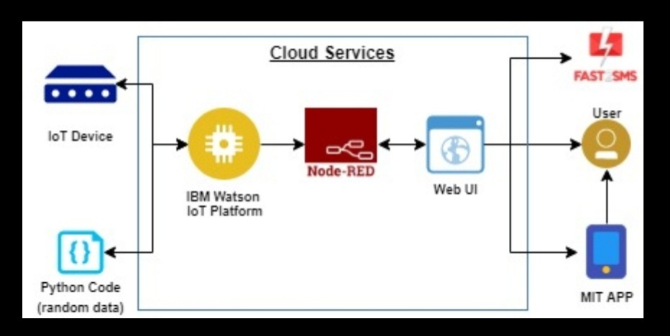
A.BLOCK DIAGRAM
B.BLOCK DIAGRAM

Slide 10
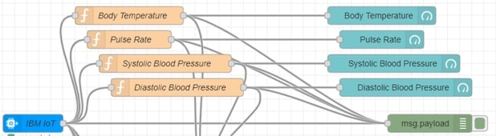
B.HARDWARE DESIGINING

Slide 11
EXPERIMENTAL INVESTIGATIONS
The display software should have features like patient details and important health parameters. In case of any emergency different alerts are to be generated to caution the front-line workers. Once we achieve this task, the doctors can download the data on their mobile phone, laptop/desktop through application software (App). In case of abnormalities in the parameters, the doctor can interact with the patient over the phone and provide medical advice. This will help our front-line warriors to avoid exposure to the infected patients and also reduce the usage of PPE kits which they had to wear for a long duration.
It also alerts the family members to take care and give particular medical treatment.

Slide 12
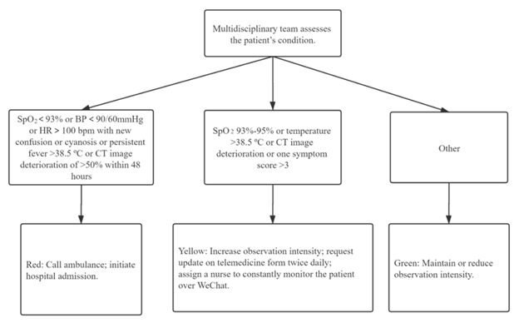
FLOWCHART

Slide 13
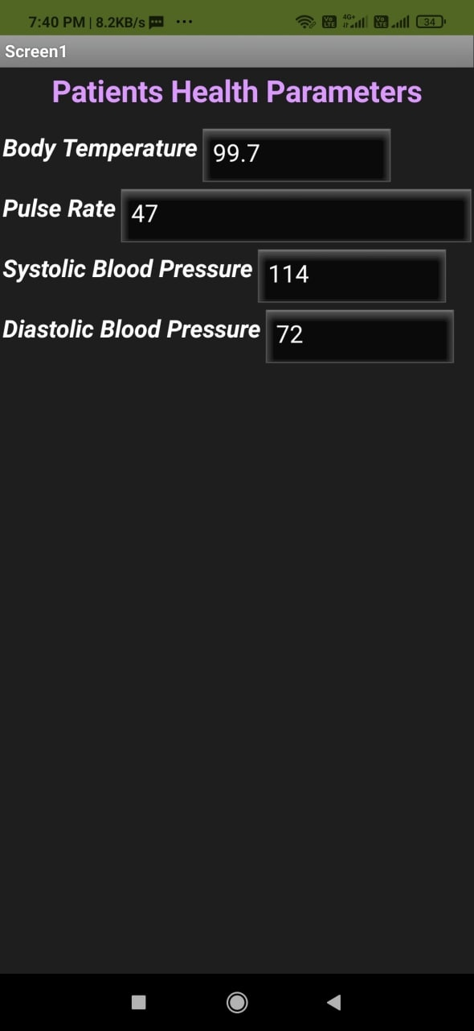
RESULT

Slide 14
ADVANTAGES AND DISADVANTAGES
Doctor’s can easily monitor the patients health parameters.
People who are suffering from COVID can easily take prescription.
Both doctor and patient can easily give medication and take medication without going to hospitals.
Security and privacy: Security and privacy remain a major concern deterring users from using IoT technology for medical purposes, as healthcare monitoring solutions have the potential to be breached .
Risk of failure: Failure or bugs in the hardware or even power failure can impact the performance of sensors and connected equipment, placing healthcare operations at risk.
Integration: There is no consensus regarding IoT protocols and standards, so devices produced by different manufacturers may not work well together.
Cost: While IoT promises to reduce the cost of healthcare in the long term, the cost of its implementation in hospitals and staff training is quite high.

Slide 15
APPLICATIONS
We have used some application like:
IBM Watson cloud
NODE-RED
MIT app inventor

Slide 16
CONCLUSION
In this work, we have proposed a health care system for the patients suffering from covid. The current work was focused mainly on making life more convenient for those with health challenges who need to visit the hospital regularly. The new system has been developed in order to reduce the number of hospital visits, queues in the hospital and reduction in the cost of taking care of the sick and also it reduces the spread of virus .
The system performs a role of health monitoring with this, users can enjoy social life and still have their health managed and monitored especially during an era of the pandemic. The proposed method will have a great impact on the quality of life by reducing the transmission rate of communicable diseases. Through this doctor can monitor patient very easily and give medication on time.

Slide 17
FUTURE SCOPE
Healing at home
A few years back, monitoring patients was limited to the care of family or home nurses in case the patient is healing at home. On the other hand, if a patient decides to be in the hospital then regular monitoring is an obvious task.
IoT health monitoring tools, the choice of healing at home becomes easy. Integration of real-time monitoring and other definite modules, patients do not necessarily require to be under the hospital roof.

Slide 18
The technology thus holds a strengthening future providing independent and mobile health monitoring while reducing the stress to visit doctors and health personnel.
Peace of mind
A patient at home with no one to look at becomes a risky affair. The situation becomes worst when a patient is suffering from COVID. Thankfully, the situation was a tension earlier that has been eliminated with the presence of IoT home health monitoring.
The addition of wearable technology into it makes it even more stronger. These wearable devices detect the patient’s condition along with sending information to the caretaker too.

Slide 19
Medicines on Right time
How many times did you forget to take medicines on time? If your answer is many times, you are somehow like me!
This issue has been cut by an IoT monitoring device that keeps track of a patient’s prescribed medicine routine. The technology can be proven best for patients with COVID.

Slide 20
BIBLIOGRAPHY
https://smartinternz.com/Student/guided_project_workspace/4789
https://smartinternz.com/Student/guided_project_info/4789#
https://www.appventurez.com/blog/iot-healthcare-future-scope/

Slide 21
APPENDIX: A.SOURCE LINK
import wiotp.sdk.device import time import random myConfig = {
"identity": {
"orgld": "dalxud",
"typeld": FIRSTdevice",
"deviceld".•" 54321",
"auth": 1
"token": "0987654321 "
def myCommandCallback(cmd):
print("Message received from IBM IOT
Platform: %s" % cmd.data[lcommand l]) client = wiotp.sdk.device.DeviceClient(config=m yConfig, logHandlers=None)
client.connect()

Slide 22
While True:
bodytemp=random.randint(-20,125) bloodpres=random.randint(0,1 00) myData={ItemperatureI:temp,
'humidityl:hum}
client.publishEvent(eventId="status", msgFormat="json", data=myData, qos=0, onPublish=None) print("Published data Successfully:
%s", myData) client.commandCallback = myCommandCallback time.sleep(2) client.disconnect()
def myCommandCallback(cmd):

Slide 23
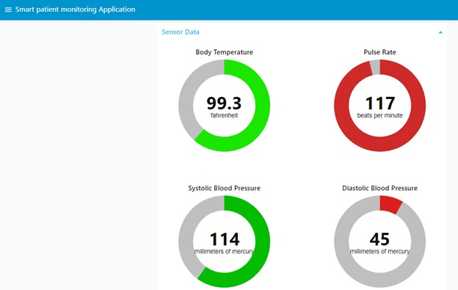
B.UI OUTPUT SCREENSHORT

Slide 24
GROPU:
G.TEJASWI NAIDU
D.RAKESH
N.PRAVEENA
A.SUVARNA
Thanks to all mentors for the quick response for doubts clearing.
--------------------------------THANK YOU---------------------------------------------

